Slide 1
Implications of Global Standing instructions (GSI) & Sandbox Policies for MFBs
ACCION CONNECT SERIES
Presentation of
Samuel Oluyemi, Head Emerging Markets & OFIs, NIBSS

Slide 2
OUTLINE
BACKGROUND
REQUIREMENTS
BASICS OF SANDBOX
GSI ELEMENTS AND PROCESSES
CHALLENGES
Notes:
2
I don’t understand point 3 & 4

Slide 3

July 13, 2020
CIRCULAR
Global Standing Instruction & Operations Guidelines
June 23, 2020
EXPOSURE DRAFT Framework for Regulatory Sandbox Operations
GOALS
Promoting Innovation
Effective Service Delivery
Healthy Competition
Financial Inclusion
GOALS
Facilitating improved credit repayment culture
Reducing Non-Performing Loans
Watch-listing consistent loan defaulters
ISSUER
Payments System Management Dept.
ISSUER
Financial Policy & Regulation Dept.
TARGET
DMBs, MMOs & PSPs
TARGET
ALL BANKS & OFIs
RESPONSE DATE
July 15, 2020
IMPLEMENTATION DATE
August 1, 2020
LOAN ELIGIBILITY
August 28, 2019

Slide 4

Motives
Confidence
Players
Processes
Trust

Slide 5
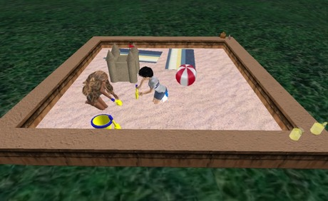
SANDBOX ENVIRONMENT
Life testing of new products or services in a controlled/test regulatory environment
An environment that provides enabling infrastructure or interfaces made available to outside Innovator or Fintech
Regulations may or may not grant regulatory relaxations for the hinted purpose of testing
Programmer has liberty to build things from the scratch
Sandbox policy will allow companies/idealist to test products or services in a closed environment, geography or among a set of users
Regulatory oversight subject to appropriate conditions and safeguards

Slide 6
Last resort by a Creditor Bank to recover past due obligations from defaulting Debtors
ELEMENTS OF THE GSI
Due Obligations
?
Points of Recoveries
Non-Performing Loans
Substandard Loans
Doubtful Loans
Loss
Principal - YES
Accrued Interests - YES
Deposit Accounts
Investment Accounts
Domiciliary Accounts
Joint Accounts
Electronic Wallets
X Penal Charges - NO

Slide 7



KYC - BVN Account Details Validation
THE PROCESSES
On agreed ToOL
Balance Enquiry/
GSI Recovery
GSI Mandate Execution
Borrower’s Engagement/Arbitration
GSI Mandate
Repository
CRMS
Full Disclosure of Information
Borrower’s Default Notification
Loan Default Definition in ToOL
Loan Granted on Comfort
Agreement on Logic of Debits
Default Observation

Slide 8
S/N | ISSUES | CHALLENGES
1. | Regulation & Sandbox Environment | Who regulates MFBs
2. | CRMS Platform | This is an electronic platform at CBN that requires appropriate handshake with PFIs
3. | BVN & Account Validation | These are electronic platforms that requires regulatory permission and some levels of integration to meet GSI requirements
4. | GSI Mandate Agreement | This is a portal based service that requires some level of integration to NIBSS
5. | Industry Customer Accounts Database (ICAD) | This is a NUBAN acceptance platform that requires timely update
6. | ICAD tagging with correct BVN | This requires critical levels of responsibility and audit trail
7. | Connectivity to the Nigeria Central Switch | This is a technology based handshake that require Fintech’s support
8. | Balance enquiry and debit advice received from NIBSS | This will be an electronic trigger that requires handshakes between PFIs and NIBSS
9. | Reports/Returns Rendition | This is an electronic based rendition

Slide 9


Nigeria Inter-Bank
Settlement System Plc
...improving the Nigeria Payments System
Thank
You!
1230 Ahmadu Bello Way Victoria Island,
Lagos, Nigeria
Tel:
+234 1 2716071-4
www.nibss-plc.com.ng

